Slide 1
Threads_and_RPC
Lecture-22

Slide 2
Introduction
How a thread in one process can call a thread on another process on same machine?
When a server thread S, starts up, it exports its interface by telling the kernel about it.
The interface defines which procedures are callable, what their parameters are, and so on.
When a client thread C starts up, it imports the interface from the kernel and is given a special identifier to use for the call.
The kernel now knows that C is going to call S later, and creates special data structures to prepare for the call.
One of these data structures is an argument stack that is shared by both C and S and is mapped into both of their address spaces.
To call the server, C pushes the arguments on to the shared stack using the normal procedure passing conventions, and then traps to the kernel, putting the special identifier in a register.
The server then changes the client’s memory map to put the client in the server’s address space and start the client thread executing the server procedure.

Slide 3
Cont..
Another technique to speed up RPCs is based on the observation that when a server thread blocks waiting for a new request, it really does not have any important context information.
Therefore, when a thread has finished carrying out a request, it simply vanishes and its stack and context information are discarded.
When a new message comes in to a server’s machine, the server kernel creates a new thread to service the request.
Furthermore, it maps the message into the server’s address space, and sets up the new thread’s stack to access the message.
This scheme is called as “implicit receive”.
The thread that is created spontaneously to handle an incoming RPC is referred to as a “pop-up thread”.
This method has several advantages over conventional RPC:
Threads do not have to block waiting for new work. Thus, no context has to be saved.
Creating a new thread is cheaper than restoring an existing one, since no context has to be restored.

Slide 4
System Models
The processors in a distributed system can be organized in two ways:
The workstation model
The processor pool model
The Workstation model:
The work station (WS) model consists of workstations that are high-end personal computers scattered throughout a building or campus and connected by a high speed LAN.
Some of the workstations may be in offices, and thus implicitly dedicated to a single user, whereas others may be in public areas and have several different users during the course of a day.
In both cases, at any instant of time, a workstation either has a single user logged into it, and thus has an owner or it is idle.

Slide 5
Cont..
In some systems the workstations have local disks and in others they do not.
The later are universally called diskless workstations, but the former are variously known as diskful workstations, or disky workstations.
Diskless workstations provide symmetry and flexibility.
A user can walk up to any workstation in the system and log in.
Since all his files are on the file server, one diskless workstation is as good as another.
Advantages:
Users have control over their work environment.
Can handle moderate workloads effectively.
Disadvantages:
Underutilization of resources if the workstation is idle.
Scalability issues when workload exceeds the capacity of a single workstation.

Slide 6
Cont..
Using Idle Workstations:
The research on idle workstation has centered on solving these problems:
1. How is an idle workstation found?
2. How can a remote process be run transparently?
3. What happens if the machine’s owner comes back?
What is an idle workstation?
A WS with no one logged in at the console.
In many systems, even if no one logged in there may be dozens of processes running: such as clock daemons, mail daemons, news daemons etc. In this case, the WS is not idle.
If no one has touched the keyboard or mouse for several minutes and no user-initiated processes are running, the WS can said to be idle.

Slide 7
Cont..
The algorithms used to locate idle WS can be divided into two categories: server driven and client driven.
In the former, when a WS goes idle, and thus becomes a potential computer server, it announces its availability.
It can do this by entering its name, network address, and properties in a registry file or database.
Later, when a user wants to execute a command on an ideal workstation, he types:
remote command
and the remote program looks in the registry to find a suitable idle workstation.
Each machine maintains its own private copy of the registry. The advantage of this is less overhead in finding an idle WS.
The disadvantage is requiring all machines to do the work of maintaining the registry.

Slide 8
Cont..
Whether there is one registry or many, there is a potential danger of race conditions occurring.
If two users invoke the remote command simultaneously, and both of them discover that the same machine is idle, they may both try to start up processes there at the same time.
To detect and avoid this situation, the remote program can check with the idol workstation, which, if still free, removes itself from the registry and gives the go-ahead sign.
At this point, the caller can send over its environment and start the remote process, as shown in the figure (next slide).

Slide 9
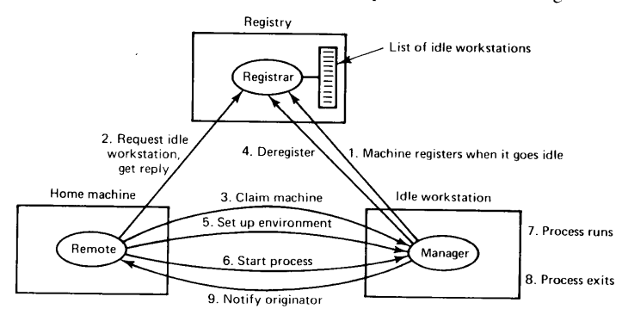
Cont..

Slide 10
Cont..
The other way to locate idle workstations is to use a client-driven approach.
When the remote is invoked, it broadcasts a request saying what program it wants to run, how much memory it needs, etc.
These details are not needed if all the workstations are identical, but if the system is heterogeneous and not every program can run on every workstation they are essential.
When the replies come back, remote picks one and sets it up.
One nice twist is to have idle workstations delay their responses slightly, with the delay being proportional to the current load.
In this way, the reply from the least heavily loaded machine will come back first and be selected.

Slide 11
Cont..
The Processor Pool Model:
Instead of dedicating workstations to individual users, a pool of processors is maintained that can be dynamically allocated to tasks.
Mechanism:
Users submit tasks to the system.
The system allocates processors from the pool based on the task requirements.
Advantages:
High flexibility in resource allocation.
Efficient utilization of processing power, especially in environments with varying workloads.
Disadvantages:
Increased overhead in managing the processor pool.
Potential for contention if multiple tasks require a large number of processors simultaneously.

